Slide 1
Supplemental on the importance of rheology BMEN30007

Slide 2
Many fluids are non-Newtonian
Many fluids are non-Newtonian
Here we will discuss two places in the Biomedical field that rely on non-Newtonian fluid flow
The flow of blood
3D bioprinting

Slide 3
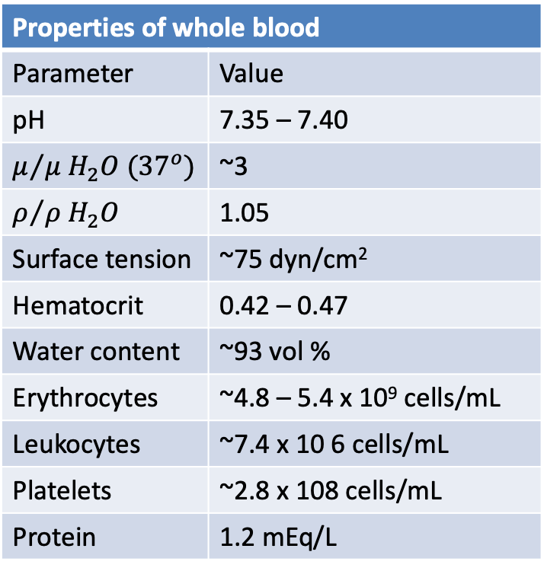
Blood is a highly non-Newtonian fluid
Blood is complex fluid and is highly non-Newtonian
Properties of whole blood
Parameter | Value
pH | 7.35 – 7.40
$$μ/{μ H_{2}O ({37}^{o})}$$ | ~3
$$ρ/{ρ H_{2}O}$$ | 1.05
Surface tension | ~75 dyn/cm²
Hematocrit | 0.42 – 0.47
Water content | ~93 vol %
Erythrocytes | ~4.8 – 5.4 x 10⁹ cells/mL
Leukocytes | ~7.4 x 10 6 cells/mL
Platelets | ~2.8 x 108 cells/mL
Protein | 1.2 mEq/L

Slide 4
What could cause the non-Newtonian behaviour?
What properties of blood would lead to non-Newtonian flow, and what non-Newtonian behaviours would you expect?
It has a large number of dissolved proteins → shear thinning flow
It has a very high loading of cells → particulate flow, shear thickening
High particle loading → yield stress
The particles are deformable → shear thinning flow

Slide 5
The rheology of blood
Truskey et al., Transport Phenomena in Biological Systems, 2009
Notes:
Apparent viscosity of RBC suspensions vs. shear rate
NP: normal RBCs in plasma;
NA: normal RBCs in saline + albumin; Saline+albumin used to match plasma viscosity HA: RBCS fixed in saline + albumin
NP: viscosity decreases with shear rate until 100 s-1 where it exhibits Newtonian behaviour (viscosity independent of shear rate)
NA: viscosity lower at low shear rates, similar to blood above 10s-1. suggest blood proteins interact with RBCs to increase blood viscosity cf RBCs in saline (fibrinogen causes RBC aggregation, break up at high shear rates so viscosity drops)
HA: RBCs rigid: approx. Newtonian but higher viscosity at high shear rates. So lower viscosity is due to deformation of RBCs (reduces work to pump blood)

Slide 6
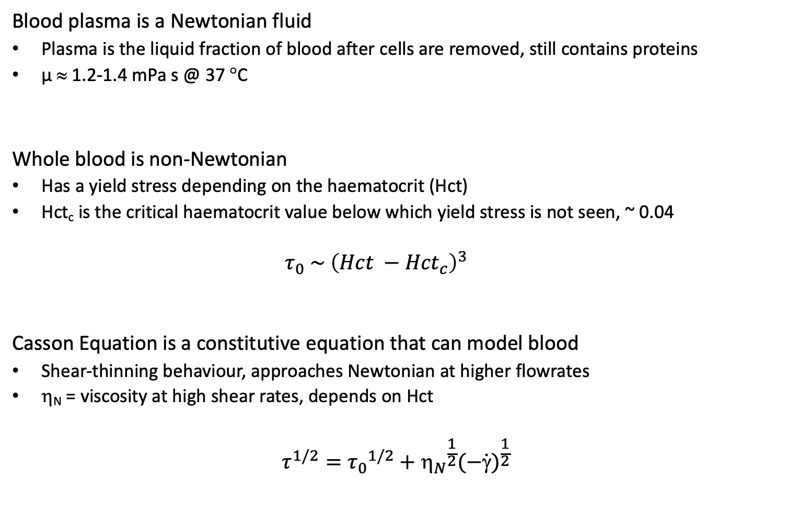
What constitutive equation is used to model blood flow?
Blood plasma is a Newtonian fluid
Plasma is the liquid fraction of blood after cells are removed, still contains proteins
µ ≈ 1.2-1.4 mPa s @ 37 °C
Whole blood is non-Newtonian
Has a yield stress depending on the haematocrit (Hct)
Hct_{c} is the critical haematocrit value below which yield stress is not seen, ~ 0.04
$$τ_{0} \sim {\left(Hct −{Hct}_{c}\right)}^{3}$$
Casson Equation is a constitutive equation that can model blood
Shear-thinning behaviour, approaches Newtonian at higher flowrates
η_{N} = viscosity at high shear rates, depends on Hct
$$τ^{1/2}={τ_{0}}^{1/2}+{η_{N}}^{\frac{1}{2}}{(−\dot{γ})}^{\frac{1}{2}}$$
Notes:
Water viscosity = 0.7 mPa s at 37C – difference in plasma due to proteins
Blood non-newtonian due to RBCs
Hematocrit: volume fraction of RBCs in the blood (~43-49% in men, 37-43% in women)
Yield stress ~ 0.02, depends on fibrinogen concentration.
Various constitutive equations, casson is one of the simplest, captures behaviour quite well (empirical)
Shear rates: carotid artery ~ 150-500 s-1

Slide 7
What causes the shear thinning behaviour?
Alignment of dissolved proteins under flow do not result in shear thinning behaviour
Plamsa (which contains all the proteins of whole blood) is Newtonian
Experiments were conducted to determine the physics that drives blood rheology
NP: RBCs were put into plasma at 45% hematocrit
NA: RBCs were put into an 11% albumin solution (same viscosity as plasma), but other types of proteins are missing
Notes:
Water viscosity = 0.7 mPa s at 37C – difference in plasma due to proteins
Blood non-newtonian due to RBCs
Hematocrit: volume fraction of RBCs in the blood (~43-49% in men, 37-43% in women)
Yield stress ~ 0.02, depends on fibrinogen concentration.
Various constitutive equations, casson is one of the simplest, captures behaviour quite well (empirical)
Shear rates: carotid artery ~ 150-500 s-1

Slide 8
What causes the shear thinning behaviour?
Results from the NA experiment show that the type of protein in the blood matters
RBCs do not interact strongly with albumin, but do interact with another blood protein, fibrinogen
At low shear stresses, the RBCs and fibrinogen aggregate
The disassembly of these aggregates causes some of the shear thinning behaviour
Shear thinning behaviour of NA is less than NP bc aggregation did not occur
Notes:
Water viscosity = 0.7 mPa s at 37C – difference in plasma due to proteins
Blood non-newtonian due to RBCs
Hematocrit: volume fraction of RBCs in the blood (~43-49% in men, 37-43% in women)
Yield stress ~ 0.02, depends on fibrinogen concentration.
Various constitutive equations, casson is one of the simplest, captures behaviour quite well (empirical)
Shear rates: carotid artery ~ 150-500 s-1

Slide 9
RBC aggregation, in pictures
NP: Normal RBCs in plasma
Plasma, static
RBC-albumin aggregate
Plasma, low shear
RBCs separate and flow
Plasma, high shear
RBCs elongate in flow
NA: Normal RBCs in albumin
Albumin, static
RBCs not aggregated
Albumin, low shear
RBCs flow
Albumin, high shear
RBCs elongate in flow
Notes:
Water viscosity = 0.7 mPa s at 37C – difference in plasma due to proteins
Blood non-newtonian due to RBCs
Hematocrit: volume fraction of RBCs in the blood (~43-49% in men, 37-43% in women)
Yield stress ~ 0.02, depends on fibrinogen concentration.
Various constitutive equations, casson is one of the simplest, captures behaviour quite well (empirical)
Shear rates: carotid artery ~ 150-500 s-1

Slide 10
What causes the shear thinning behaviour?
Experiments were conducted to determine the physics that drives blood rheology
NP: RBCs were put into plasma at 45% haematocrit
NA: RBCs were put into an 11% albumin solution (same viscosity as plasma), but other types of proteins are missing
HA: RBCs were first hardened so that they could not deform, they were then put into an 11% albumin solution (same viscosity as plasma), but other types of proteins are missing.
Notes:
Water viscosity = 0.7 mPa s at 37C – difference in plasma due to proteins
Blood non-newtonian due to RBCs
Hematocrit: volume fraction of RBCs in the blood (~43-49% in men, 37-43% in women)
Yield stress ~ 0.02, depends on fibrinogen concentration.
Various constitutive equations, casson is one of the simplest, captures behaviour quite well (empirical)
Shear rates: carotid artery ~ 150-500 s-1

Slide 11
What causes the shear thinning behaviour?
Results from the HA experiment show that flexibility of the RBCs matter
RBCs deform in shear flow and become elongated in the flow direction
This deformation at higher shear allows them to flow past each other more easily
This is macroscopically observed as shear thinning behaviour
Notes:
Water viscosity = 0.7 mPa s at 37C – difference in plasma due to proteins
Blood non-newtonian due to RBCs
Hematocrit: volume fraction of RBCs in the blood (~43-49% in men, 37-43% in women)
Yield stress ~ 0.02, depends on fibrinogen concentration.
Various constitutive equations, casson is one of the simplest, captures behaviour quite well (empirical)
Shear rates: carotid artery ~ 150-500 s-1

Slide 12
RBC deformation, in pictures
NA: Normal RBCs in albumin
Albumin, static
RBCs not aggregated
Albumin, low shear
RBCs flow
Albumin, high shear
RBCs elongate in flow
HA: Hardened RBCs in plasma
Plasma, static
RBC-albumin aggregate
Plasma, low shear
RBCs separate and flow
Plasma, high shear
RBCs cannot elongate in flow
Notes:
Water viscosity = 0.7 mPa s at 37C – difference in plasma due to proteins
Blood non-newtonian due to RBCs
Hematocrit: volume fraction of RBCs in the blood (~43-49% in men, 37-43% in women)
Yield stress ~ 0.02, depends on fibrinogen concentration.
Various constitutive equations, casson is one of the simplest, captures behaviour quite well (empirical)
Shear rates: carotid artery ~ 150-500 s-1

Slide 13
Why is this behaviour imporatnt?
Shear rates throughout the body vary drastically with vessel diameter and disease state
The shear thinning allows us to model blood flow throughout the body
Sakariassen et al. Future Sci. OA (2015) 1(4), FSO30
Notes:
Blood vessels respond actively to changes in blood flow rate, pressure, drugs etc.
Can constrict / dilate due to arterial smooth muscle cell stimulation, vasodilators and vasoconstrictors released by endothelial cells
Pathological constriction of blood vessels : stenosis

Slide 14
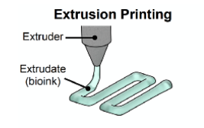
3D bioprinting, a whole lot of rheology
3D bioprinting includes the extrusion of cell-laden hydrogels to make tissue-like structures
A syringe filled with a hydrogel and cells
The fluid is extruded in a controlled manner to create the desired structure
How are rheological properties important in this process?
What rheological fluid properties would be important for the bioink?
Notes:
Blood vessels respond actively to changes in blood flow rate, pressure, drugs etc.
Can constrict / dilate due to arterial smooth muscle cell stimulation, vasodilators and vasoconstrictors released by endothelial cells
Pathological constriction of blood vessels : stenosis

Slide 15
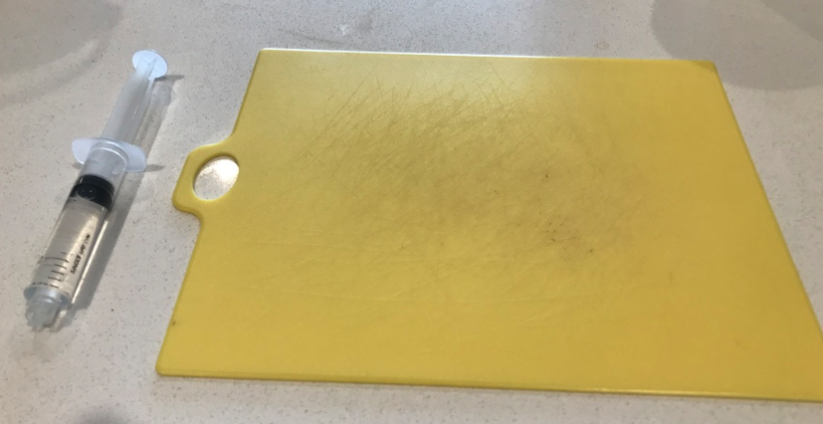
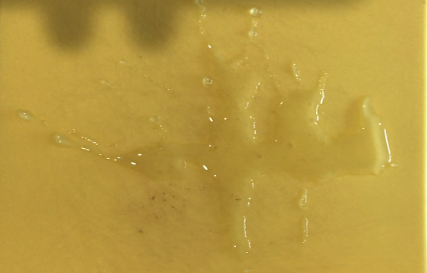
My home 3D printing failure
I tried to print 2 Newtonian fluids
Water
Honey
It did not go well…because the fluids don’t have the right rheological properties (and I didn’t have the correct equipment)
3D printing water…
Before printing
Immediately after printing
Notes:
Blood vessels respond actively to changes in blood flow rate, pressure, drugs etc.
Can constrict / dilate due to arterial smooth muscle cell stimulation, vasodilators and vasoconstrictors released by endothelial cells
Pathological constriction of blood vessels : stenosis

Slide 16
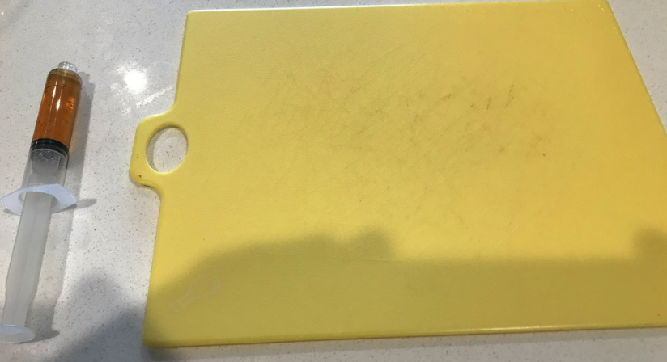
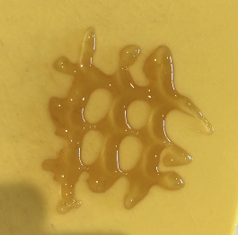
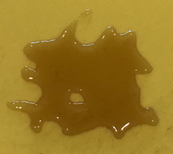
My home 3D printing failure
3D printing honey…
Before printing
Immediately after printing
(not a total train wreck)
Ten minutes later
(total train wreck)
Notes:
Blood vessels respond actively to changes in blood flow rate, pressure, drugs etc.
Can constrict / dilate due to arterial smooth muscle cell stimulation, vasodilators and vasoconstrictors released by endothelial cells
Pathological constriction of blood vessels : stenosis

Slide 17
Take aways
Rheology is important in a large number of fluid flow applications
Blood flow
3D printing
Take away messages
Be able to analyse a system and determine what rheological properties are required
Determine how various fluids would behave if used in the same system

